Slide 1
CHGM-141
General and Analytical Chemistry I
Lecture 1(b)
(Ch. 0) with Dr. Bailey
Measurement
Significant Figures
Scientific Notation
Precision and Accuracy

Slide 2
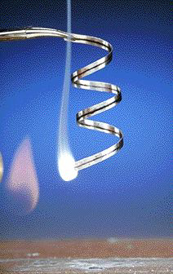
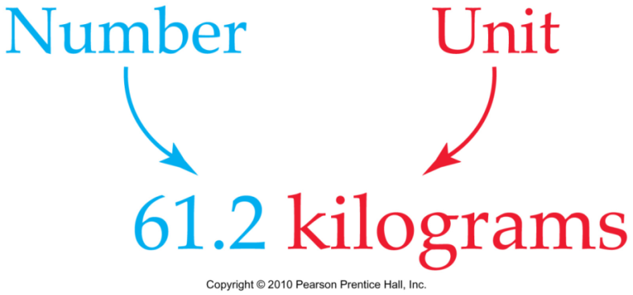
Types of Observations and Measurements
We make QUALITATIVE observations of reactions — changes in color and physical state.
We also make QUANTITATIVE MEASUREMENTS, which involve numbers and units
.

Slide 3
The Importance of Measurements
In chemical laboratories the most common types of Measurements are those of
mass
volume
length
time
temperature
pressure
concentration

Slide 4
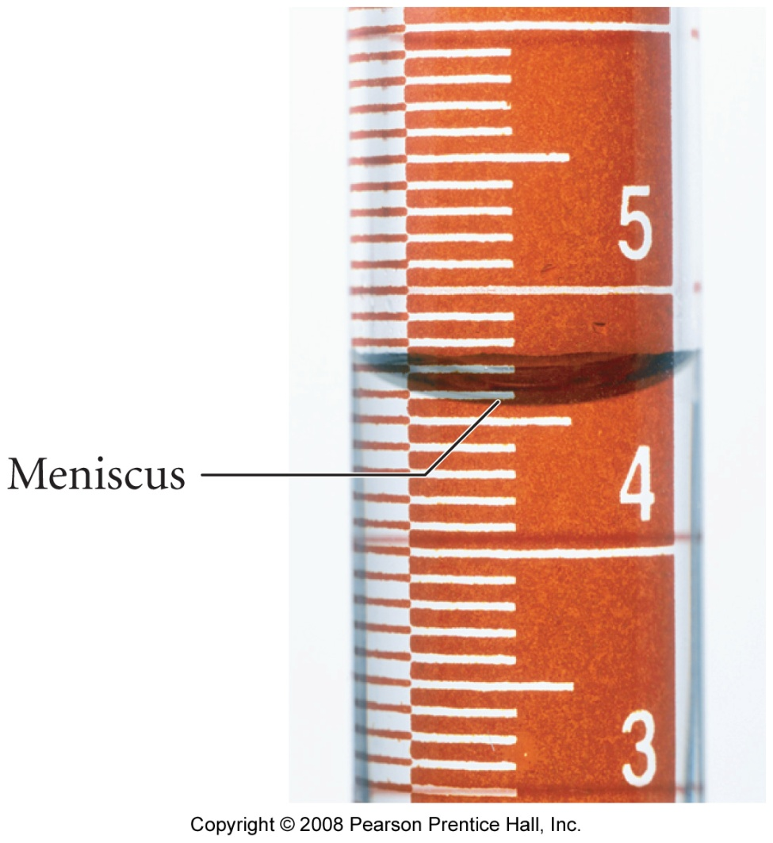
What Is a Measurement?
every measurement has a number and a unit
comparison to an agreed- upon standard
the unit tells you what standard you are comparing your object to
the number tells you
  What multiple of the standard the object measures
  The uncertainty in the measurement
4.56 mL
Estimating the Last Digit
Estimating the Last Digit

Slide 5
Estimating the Last DigitAccuracy, Precision, and Significant Figure s
1. For instruments marked with a
scale, you get the last digit by
estimating between the marks if possible
2. Mentally divide the space into 10 equal spaces, then estimate how many spaces over the indicator mark is
Markings every 0.1 cm
0
1
2
3
4
cm
1.7 cm < length < 1.8 cm
length = 1.74 cm
The non-place-holding digits in a reported measurement are called significant figures
Scientific measurements are reported so that every digit written is certain, except the last one which is estimated

Slide 6
Significant Figures
the non-place-holding digits in a reported measurement are called significant figures
significant figures tell us the range of values to expect for repeated measurements
  the more significant figures there are in a measurement, the smaller the range of values is
12.3 cm
has 3 sig. figs.
and its range is
12.2 to 12.4 cm
12.30 cm
has 4 sig. figs.
and its range is
12.29 to 12.31 cm
Example
(different tools –different number of Significant Figures) …

Slide 7
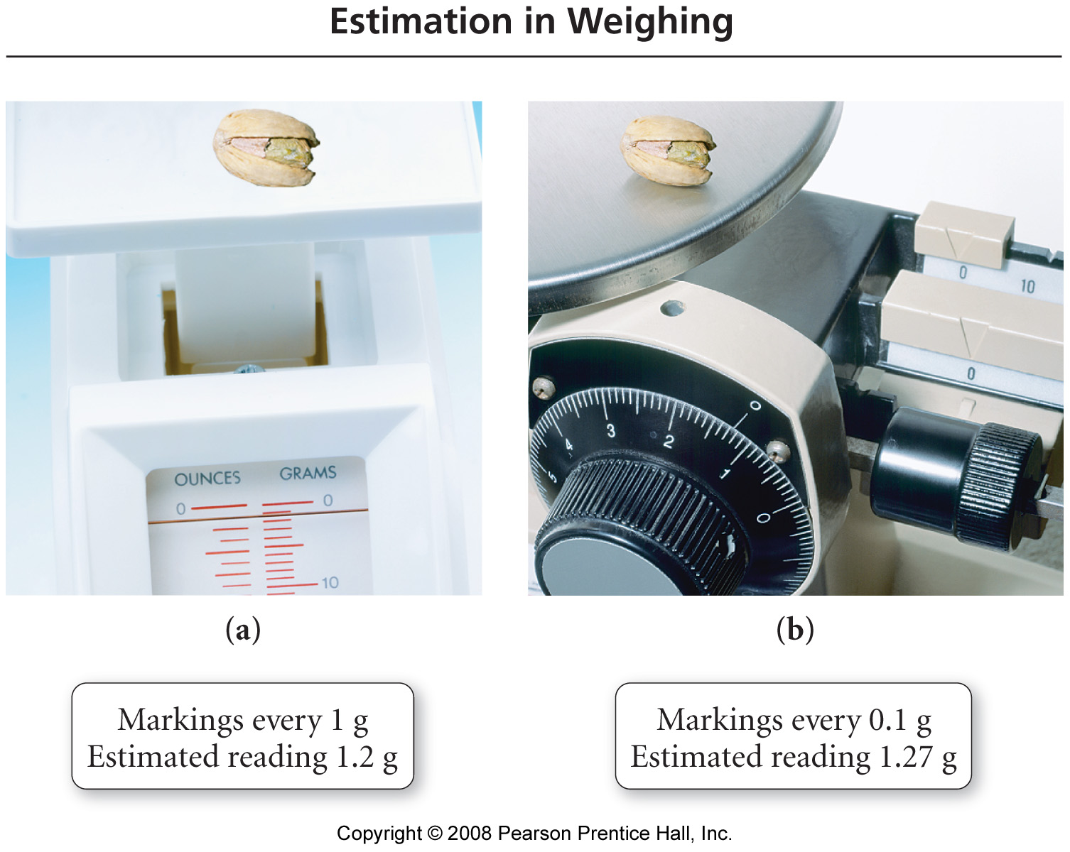
  the more significant figures there are in a measurement, the smaller the range of values is. More precise measurement is!

Slide 8
What Color Do You Like?
Green
Red
Brown
Gray

Slide 9
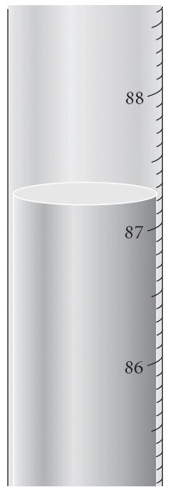
Read the temperature with the correct number of significant figures.
87°C
87.2°C
87.24°C
87.240°C
87.2400°C

Slide 10
Read the temperature with the correct number of significant figures.
87°C
87.2°C
87.24°C
87.240°C
87.2400°C

Slide 11
Counting Significant Figures
All non-zero digits are significant
  1.5 has 2 sig. figs.
Interior zeros are significant
  1.05 has 3 sig. figs.
Leading zeros are NOT significant (the decimal point location)
  0.001050 has 4 sig. figs.
    1.050 x 10⁻³

Slide 12
Counting Significant Figures
Trailing zeros may or may not be significant
  Trailing zeros after a decimal point are significant
    1.050 has 4 sig. figs.
  Zeros at the end of a number without a written decimal point are ambiguous and should be avoided by using scientific notation
    if 150 has 2 sig. figs. then 1.5 x 10²
    but if 150 has 3 sig. figs. then 1.50 x 10²

Slide 13
Writing Numbers in Scientific Notation
1. Locate the decimal point.
2. Move the decimal point to obtain a number between 1 and 10.
3. Multiply the new number by 10^{n} .
  Where n is the number of places you moved the decimal point.
4. If you moved the decimal point to the left, then n is +; if you moved it to the right, then n is − .
  If the original number is 1 or larger, then n is + .
  If the original number is less than 1, then n is − .
.
12340…

Slide 14
Writing a Number in Scientific Notation, Continued
12340
1. Locate the decimal point.
12340.
2. Move the decimal point to obtain a number between 1 and 10.
1.234
3. Multiply the new number by 10^{n} .
  Where n is the number of places you moved the decimal point.
1.234 x 10⁴
4. If you moved the decimal point to the left, then n is +; if you moved it to the right, then n is − .
1.234 x 10⁴
Ex: 0.00012340

Slide 15
Writing a Number in Scientific Notation, Continued
0.00012340
1. Locate the decimal point.
0.00012340
2. Move the decimal point to obtain a number between 1 and 10.
1.2340
3. Multiply the new number by 10^{n} .
  Where n is the number of places you moved the decimal point.
1.2340 x 10⁴
4. If you moved the decimal point to the left, then n is +; if you moved it to the right, then n is − .
1.2340 x 10⁻⁴

Slide 16
Example: Determining the Number of Significant Figures in a Number
How many significant figures are in each of the following?
0.04450 m
5.0003 km
10 dm = 1 m
1.000 × 10⁵ s
0.00002 mm
10,000 m
4 sig. figs.; the digits 4 and 5, and the trailing 0
5 sig. figs.; the digits 5 and 3, and the interior 0’s
infinite number of sig. figs., exact numbers
4 sig. figs.; the digit 1, and the trailing 0’s
1 sig. figs.; the digit 2, not the leading 0’s
Ambiguous, generally assume 1 sig. fig.

Slide 17
Significant Figures and Exact Numbers
Exact numbers have an unlimited number of significant figures
A number whose value is known with complete certainty is exact
  from counting individual objects
  from definitions
    1 cm is exactly equal to 0.01 m
  from integer values in equations
    in the equation for the radius of a circle, the 2 is exact
diameter of a circle
2
radius of a circle =

Slide 18
Multiplication and Division with Significant Figures
when multiplying or dividing measurements with significant figures, the result has the same number of significant figures as the measurement with the fewest number of significant figures (least precise measurement)
5.02 × 89.665 × 0.10 = 45.0118 = 45
3 sig. figs. 5 sig. figs. 2 sig. figs. 2 sig. figs.
5.892 ÷ 6.10 = 0.96590 = 0.966
4 sig. figs. 3 sig. figs. 3 sig. figs.

Slide 19
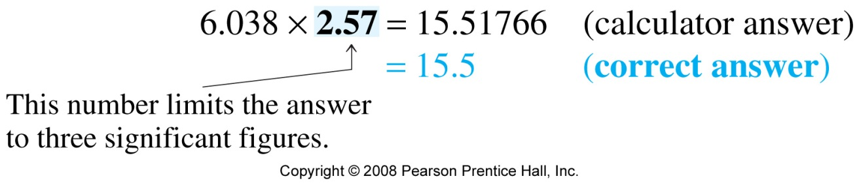
Sample Problem

Slide 20
Multiplication / Division
(Sample Problem)
For multiplication and division, the number of significant figures in the answer should not be greater than the number of significant figures in the least precise measurement.
E.g. Find the area:
Length x width
8.7 cm
3.254 cm
8.7cm x 3.254cm = 28.3098 cm² = 28 cm²
And…Addition/Subtraction…

Slide 21
Addition and Subtraction with Significant Figures
when adding or subtracting measurements with significant figures, the result has the same number of decimal places as the measurement with the fewest number of decimal places
5.74 + 0.823 + 2.651 = 9.214 = 9.21
2 dec. pl. 3 dec. pl. 3 dec. pl. 2 dec. pl.
4.8 - 3.965 = 0.835 = 0.8
1 dec. pl 3 dec. pl. 1 dec. pl.

Slide 22
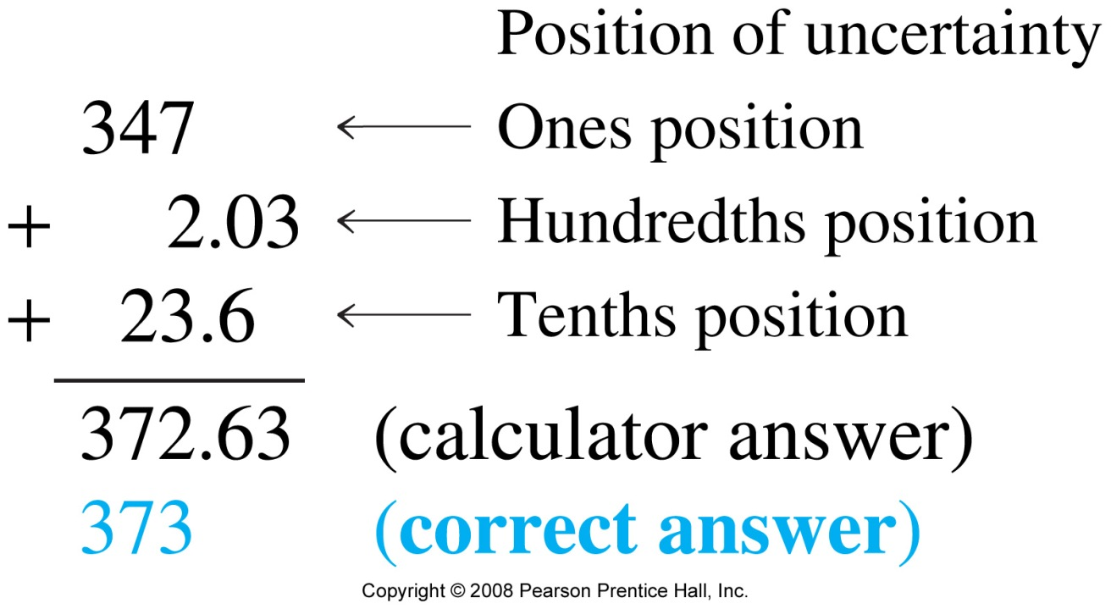
Sample Problem

Slide 23
Addition / Subtraction
(Sample Problem)
For addition and subtraction, the answer should have the same number of decimal places as the quantity with the fewest number of decimal places
E.g. Find the perimeter:
Length
8.7 cm
width
3.254 cm
Perimeter = 8.7 + 8.7 + 3.254 + 3.254
= 23.908 cm
=23.9 cm

Slide 24
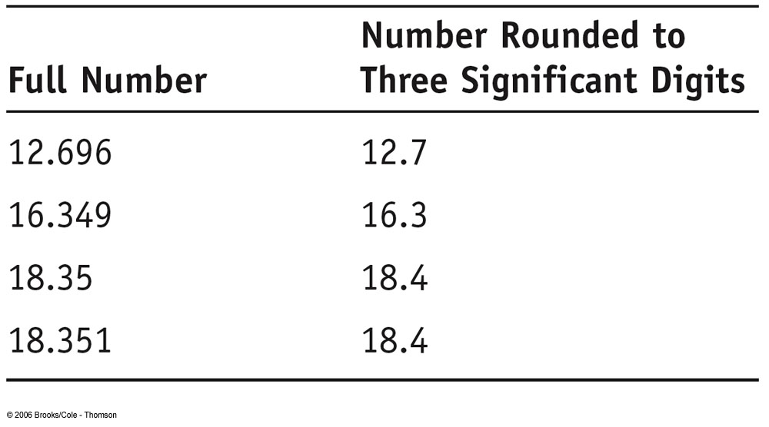
Rounding
When rounding to the correct number of significant figures, if the number after the place of the last significant figure is
0 to 4, round down
  drop all digits after the last sig. fig. and leave the last sig. fig. alone
5 to 9, round up
  drop all digits after the last sig. fig. and increase the last sig. fig. by one

Slide 25
Rounding (examples)
rounding to 2 significant figures
2.34 rounds to 2.3
  because the 3 is where the last sig. fig. will be and the number after it is 4 or less
2.37 rounds to 2.4
  because the 3 is where the last sig. fig. will be and the number after it is 5 or greater
2.349865 rounds to 2.3
  because the 3 is where the last sig. fig. will be and the number after it is 4 or less

Slide 26
Rounding (examples)
rounding to 2 significant figures
0.0234 rounds to 0.023 or 2.3 × 10⁻²
  because the 3 is where the last sig. fig. will be and the number after it is 4 or less
0.0237 rounds to 0.024 or 2.4 × 10⁻²
  because the 3 is where the last sig. fig. will be and the number after it is 5 or greater
0.02349865 rounds to 0.023 or 2.3 × 10⁻²
  because the 3 is where the last sig. fig. will be and the number after it is 4 or less

Slide 27
Rounding (examples)
rounding to 2 significant figures
234 rounds to 230 or 2.3 × 10²
  because the 3 is where the last sig. fig. will be and the number after it is 4 or less
237 rounds to 240 or 2.4 × 10²
  because the 3 is where the last sig. fig. will be and the number after it is 5 or greater
234.9865 rounds to 230 or 2.3 × 10²
  because the 3 is where the last sig. fig. will be and the number after it is 4 or less

Slide 28
Both Multiplication/Division and Addition/Subtraction with Significant Figures
when doing different kinds of operations with measurements with significant figures, do whatever is in parentheses first, evaluate the significant figures in the intermediate answer, then do the remaining steps
3.489 × (5.67 – 2.3) =
2 dp 1 dp
3.489 × 3.37 = 12
4 sf 1 dp & 2 sf 2 sf
To avoid accumulating extra error from rounding, round only at the end, keeping track of the last sig. fig. for intermediate calculations

Slide 29
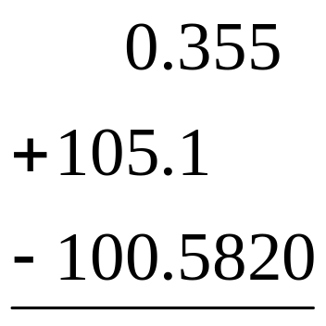
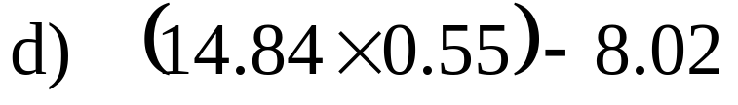
Example: Perform the following calculations to the correct number of significant figures
b)

Slide 30
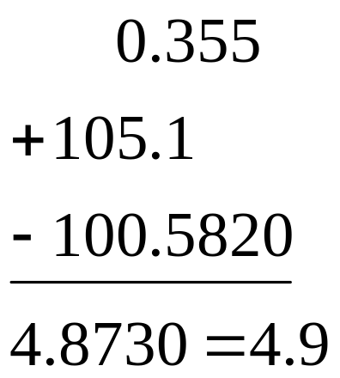
Example 1.6 Perform the following calculations to the correct number of significant figures
b)

Slide 31
Precision and Accuracy

Slide 32
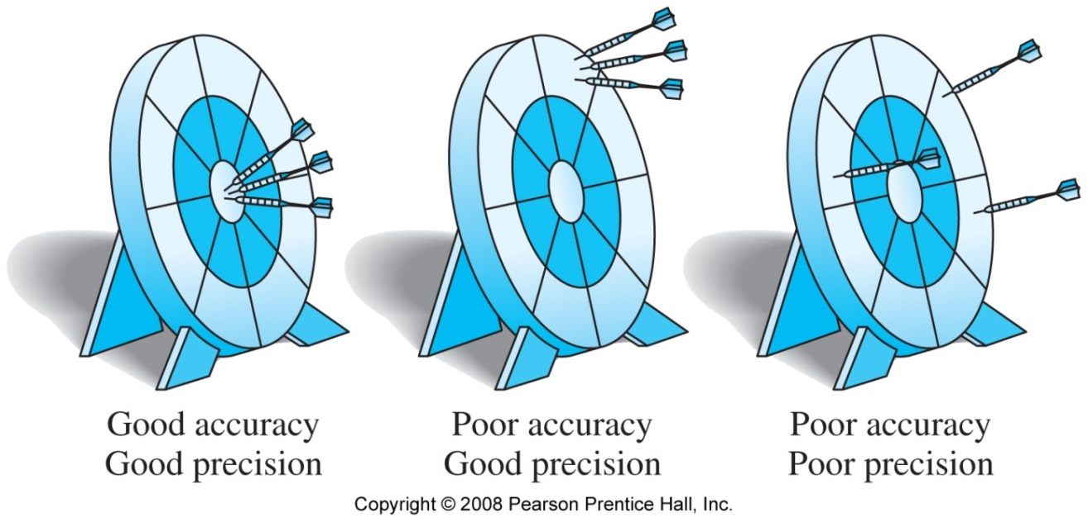
Uncertainty in Measurement
Precision is a measure of how closely individual measurements agree with one another (an indication of how reproducible a measurement is).
Accuracy refers to how closely individual measurements agree with the correct, or “true”, value.
The analogy of darts stuck in a dartboard:

Slide 33
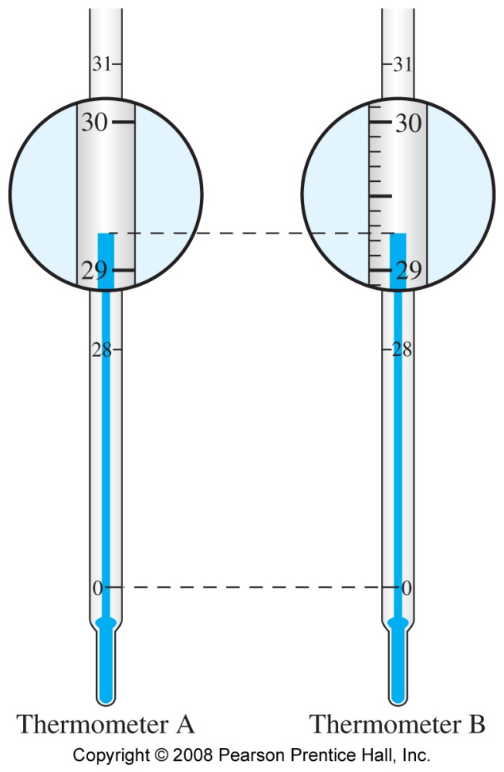
To understand how reliable a measurement is we need to understand the limitations of the measurement
Which thermometer is more precise?
  the more significant figures there are in a measurement, the smaller the range of values is
Uncertainty comes from
limitations of the instruments used for comparison,
the experimental design,
the experimenter,
nature’s random behavior
29.2 °C
29.25 °C

Slide 34

Precision
imprecision in measurements (how reproducible a measurement is) is caused by random errors
  errors that result from random fluctuations
  no specific cause, therefore cannot be corrected
even though every measurement has some random error, with enough measurements these errors should average out

Slide 35
Accuracy
inaccuracy in measurement caused by systematic errors
  errors caused by limitations in the instruments or techniques or experimental design
  can be reduced by using more accurate instruments, or better technique or experimental design
systematic errors do not average out with repeated measurements because they consistently cause the measurement to be either too high or too low

Slide 36
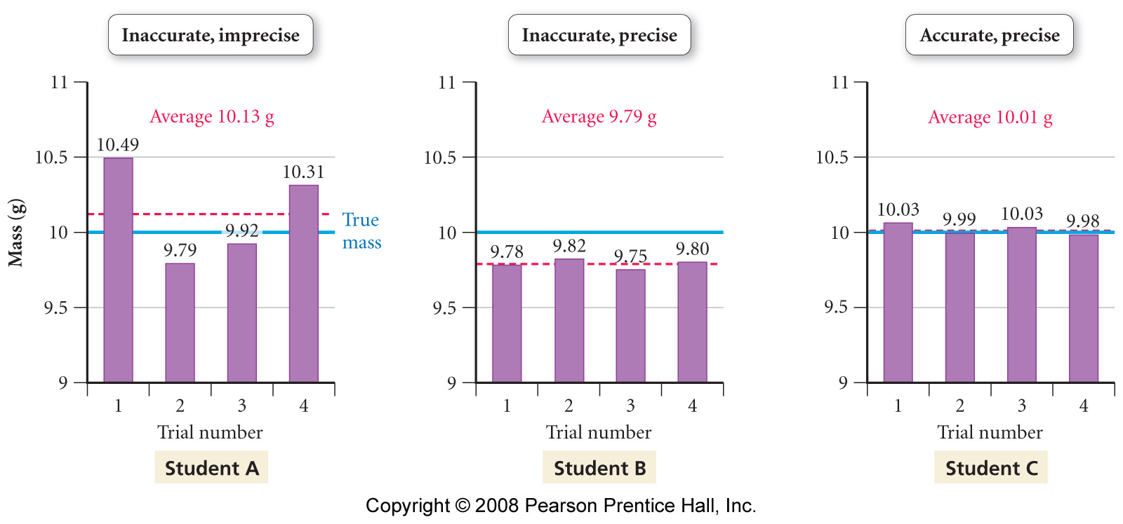
Accuracy vs. Precision

